Slide 1


REVEAL-X
F Y P · P A R T 1 2 0 2 6
S E C U R E - B Y - D E S I G N
Secure Image Sharing using Visual Cryptography
with AI Enhancement & Tamper Detection
P R E S E N T E D B Y
Inam Ullah (45521)
Zaka Khan (36503)
Muhammad Umar (44726)
S U P E R V I S O R
Sir Yawar Abbas
Dept. of Cyber Security Riphah International University

Slide 2
Agenda
P R E S E N T A T I O N O U T L I N E
What we cover in this FYP Part 1 progress review.
01 Problem, background & objectives
02 Project scope
03 Proposed solution & how it works
04 Methodology & requirements
05 Architecture & security
06 Comparison & walkthroughs
07 Progress, timeline & challenges
08 FYP Part 2 & conclusion

Slide 3
0 1 — T H E P R O B L E M
When images travel, privacy doesn't.
Standard messaging hides data in transit, but a single intercepted file or compromised server still exposes everything in plain sight.
4.1B
Records exposed
in data breaches in a single year.
100%
Server trust required
in typical end-to-end systems.
0
Useful data in a share
if only one fragment is leaked.
The gap: we need a system where intercepting any single piece reveals nothing at all.

Slide 4
A 1994 idea, re-engineered
0 2 — B A C K G R O U N D
Visual Cryptography splits a secret image into shares that are individually pure noise — the image reappears only when the shares combine, with no decryption key required.
K E Y L E S S
F U T U R E - P R O O F
T H E G A P
Quality loss
No keys to steal
Quantum-resistant
Security is information-theoretic, not computational — there is no key to crack or leak.
Unlike AES or RSA, secrecy does not rely on computational hardness that quantum computers threaten.
Classical VC suffers pixel expansion and degraded output — Reveal-X closes that gap with AI.
Source: Naor & Shamir, “Visual Cryptography” — EUROCRYPT 1994.

Slide 5
Aims & objectives
0 3 — A I M S & O B J E C T I V E S
What Reveal-X sets out to prove in FYP Part 1.
A I M
Build a real-time messenger where intercepting a single image share reveals nothing — privacy guaranteed by mathematics, not server trust.
01
Visual cryptography
Split every image into two XOR shares; reconstruct only on the recipient device.
02
Real-time messaging
Instant text over WebSockets with typing, receipts and presence.
03
04
Security hardening
Defend against XSS and brute-force with DOMPurify and scrypt.
Installable PWA
Ship an accessible, offline-capable glassmorphic dark UI.

Slide 6
Project scope
0 4 — P R O J E C T S C O P E
Clear boundaries for Part 1 vs Part 2.
I N S C O P E — F Y P P A R T 1
Delivered now
2-of-2 visual cryptography image sharing
Real-time messaging, typing & presence
XSS & brute-force hardening (DOMPurify, scrypt)
ECDH key-generation UI (WebCrypto)
Installable PWA, glassmorphic dark UI
O U T O F S C O P E — F Y P P A R T 2
Planned next
ML-based tamper detection
AI image enhancement & upscaling
Full peer-to-peer E2E key tunnel
Advanced theming & animation polish

Slide 7
Reveal-X
0 5 — T H E S O L U T I O N
A real-time messaging app that splits every image into two meaningless shares — neither share alone reveals anything.
1
2
3
Visual Cryptography
Real-Time Messaging
AI Enhancement
XOR 2-of-2 secret sharing splits each image into two random-looking shares.
Instant delivery of shares between users over secure WebSocket channels.
Reconstructed images are sharpened and denoised for clarity on recovery.
4
5
Tamper Detection
Zero-Knowledge Server
Integrity hashing flags any share that was altered in transit.
The server relays shares but can never reconstruct the original image.

Slide 8
How it works
0 6 — H O W I T W O R K S
Share A⊕Share B=Original
1
Split
Each pixel is XOR-divided into two random shares.
2
Send
Only Share 1 crosses the network; Share 2 stays in the receiver’s browser.
3
Combine
XOR re-applies to perfectly rebuild the original.
4
Enhance
AI sharpens the recovered image for the viewer.
The server only ever sees Share 1 — it never holds both, so it can never rebuild the image.

Slide 9
Methodology
0 7 — M E T H O D O L O G Y
An iterative build-and-validate approach.
01
02
03
04
Research
Study Naor–Shamir visual cryptography and the image-interception threat model.
Design
Define the three-tier architecture, share scheme and zero-knowledge relay.
Build
Implement shares, real-time messaging and hardening in iterative increments.
Validate
Confirm a single intercepted share is information-theoretically useless.

Slide 10
Requirements
0 8 — R E Q U I R E M E N T S
What the system must do, and how well.
F U N C T I O N A L
What it must do
Split each image into two random shares
Transmit only Share 1 over the network
Reconstruct the image locally on device
Real-time text, typing & presence
Account registration and login
N O N - F U N C T I O N A L
How well it must do it
Information-theoretic image secrecy
Sub-second message delivery
WCAG 2.1 AA accessibility
Offline-capable, installable PWA
Resistant to XSS and brute-force

Slide 11
How Reveal-X compares
0 9 — C O M P A R I S O N
Mainstream messengers all rely on computational encryption. None apply visual cryptography to image privacy.
Capability | WhatsApp | Telegram | Signal | Reveal-X
End-to-end Encryption | Yes | Optional (Opt-in) | Yes | Yes
Image Protection Mechanism | AES Keys | AES Keys | AES Keys | Visual Cryptography
Server Can Reconstruct Image | Stored on Server | Stored on Server | No | Never
Security Guarantee | Computational Security | Computational Security | Computational Security | Information-Theoretic Security
Share-Level Tamper Detection | No | No | No | Available (Part 2)
Note: No mainstream messenger applies visual cryptography to images — Reveal-X targets that gap.

Slide 12



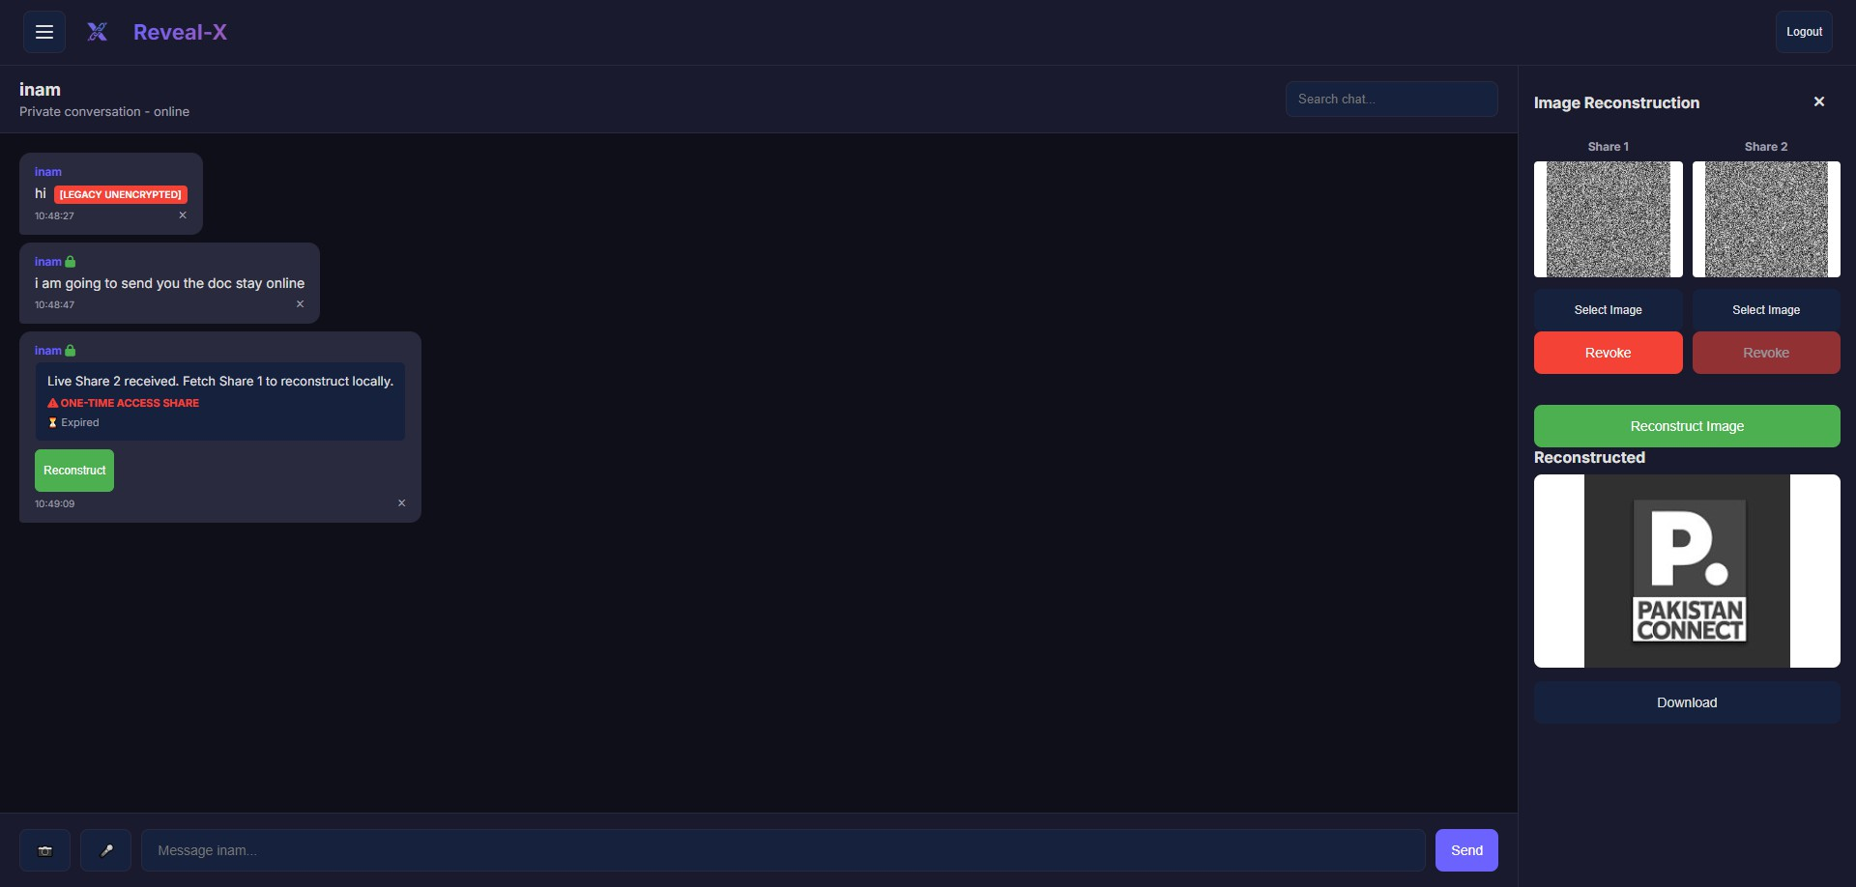
Real-time messaging
reveal-x · messaging
1 0 — W A L K T H R O U G H
+
Paste your screenshot
^{her}Meessaging / chat interface
→
Instant WebSocket delivery with typing indicators and read receipts.
→
Presence tracking shows who is online in real time.
→
Glassmorphic dark UI, installable as a Progressive Web App.

Slide 13
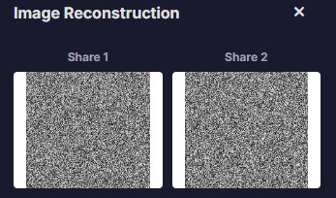

Visual cryptography in action
1 1 — W A L K T H R O U G H
Capture the noisy share as it travels, then the clear image rebuilt only in the receiver’s browser.
S H A R E 1 — O V E R T H E N E T W O R K
R E C O N S T R U C T E D — I N B R O W S E R
+
Paste your screenshot
+
Paste your screenshot
here
Encrypted noise share
here
Recovered clear image

Slide 14
Three tiers, one secure flow
1 2 — A R C H I T E C T U R E
A clean separation between what the user sees, where logic runs, and where data rests.
C L I E N T
A P P L I C A T I O N
P E R S I S T E N C E
Presentation
Logic & Relay
Storage
Glassmorphic dark UI (PWA)WebCrypto + DOMPurifyLocal Share 2 generation
Python + FlaskFlask-SocketIO (WebSockets)scrypt auth via Werkzeug
scrypt-hashed credentialsMessage & session metadataIntegrity hash records
Client→Application→Persistence— shares only, never the original.

Slide 15
Defense at every layer
1 3 — S E C U R I T Y H A R D E N I N G
XSS PREVENTION
PASSWORD SECURITY
DOMPurify + escaping
Client-side DOMPurify and strict server-side HTML escaping neutralise injected scripts.
scrypt hashing
Werkzeug scrypt hashing resists GPU brute-force — plaintext passwords are never stored.
KEY EXCHANGE
ZERO-KNOWLEDGE
ECDH via WebCrypto
Key pairs are generated locally in the browser with the native WebCrypto API.
Blind server relay
The server forwards Share 1 it can never combine — it holds no recoverable image.

Slide 16
Built with
1 4 — T E C H S T A C K
F R O N T E N D
Glassmorphic dark UI · WCAG 2.1 AAProgressive Web App · Service WorkerWebCrypto API · DOMPurify
B A C K E N D
Python · FlaskFlask-SocketIO · WebSocketsWerkzeug · scrypt hashing
C R Y P T O G R A P H Y
2-of-2 visual cryptography (XOR)ECDH key generationShare-level integrity hashing
R E A L - T I M E
Bidirectional WebSocket eventsTyping indicators · read receiptsLive presence tracking

Slide 17
Progress so far
1 5 — P R O G R E S S
Every FYP Part 1 deliverable is complete.
✓
Visual cryptography sharing
XOR 2-of-2 shares with local Canvas reconstruction.
C O M P L E T E
✓
Real-time messaging
WebSocket delivery with typing, receipts and presence.
C O M P L E T E
✓
Security hardening
DOMPurify XSS defense and scrypt password hashing.
C O M P L E T E
✓
ECDH key-generation UI
WebCrypto public / private key demonstration.
C O M P L E T E
✓
Progressive Web App
Installable, offline-capable, glassmorphic UI.
C O M P L E T E

Slide 18


Project timeline
1 6 — P R O J E C T T I M E L I N E
From a completed Part 1 to the Part 2 roadmap.
F Y P P A R T 1 — C O M P L E T E D
Research
Design
Core build
Hardening
PWA
F Y P P A R T 2 — P L A N N E D
ML tamper detect
AI enhancement
P2P E2E
Evaluation
Release

Slide 19
Challenges & mitigation
1 7 — C H A L L E N G E S
Hard problems, and how we addressed them.
01
Pixel expansion & quality loss
Reconstruct locally on Canvas now; AI enhancement planned for Part 2.
02
Share 2 persistence
Held in live session memory only — never written to disk.
03
04
XSS in chat content
DOMPurify sanitization plus strict server-side escaping.
Real-time scale
Event-driven Flask-SocketIO duplex channels.

Slide 20
What's next
1 8 — F Y P P A R T 2
Part 1 proves the concept. Part 2 adds the deep-learning layer and a formal evaluation.
P H A S E 0 1
AI super-resolution
P H A S E 0 2
ML tamper detection
P H A S E 0 3
Evaluate quality
P H A S E 0 4
Deploy
ESRGAN / CNN models denoise and upscale reconstructed shares.
A CNN classifier flags shares whose pixel statistics were altered.
Measure reconstruction with PSNR and SSIM against the original.
Ship a stable release with complete documentation.

Slide 21
Conclusion
1 9 — C O N C L U S I O N
Where Reveal-X stands today.
01
02
Privacy by mathematics
A single intercepted share is information-theoretically worthless.
Zero-knowledge relay
The server transports shares but never reconstructs an image.
03
04
Part 1 complete
Visual cryptography, messaging and hardening are shipped.
Part 2 ahead
ML tamper detection and AI image enhancement come next.

Slide 22
References
2 0 — R E F E R E N C E S
Key sources and standards.
[1] M. Naor and A. Shamir, "Visual Cryptography," Advances in Cryptology — EUROCRYPT ’94, LNCS vol. 950, pp. 1–12, 1995.
[2] W3C, "Web Cryptography API," W3C Recommendation, 2017.
[3] Pallets Projects, "Werkzeug — scrypt password hashing," Official documentation.
[4] Cure53, "DOMPurify — DOM-only XSS sanitizer," Open-source library.
[5] M. Grinberg, "Flask-SocketIO — real-time WebSocket framework," Official documentation.

Slide 23


P R O J E C T T E A M
Inam Ullah (45521)
Zaka Khan (36503)
Muhammad Umar (44726)
Thank you
Reveal-X makes intercepting a single share worthless
— privacy by mathematics, not by trust.
S U P E R V I S O R
Sir Yawar Abbas
Dept. of Cyber Security
Riphah International University · 2026

